Slide 1


High Five
Name | Student ID
Mahmudul Hasan Shihan | 2221081098
Abdur Razzzak | 2221081081
Nure Alam Akond Shadin | 2221081095
Nusrat Tabassum | 2221081101
Siyam Khan | 2221081103

Slide 2

Economic
Condition of Bangladesh

Slide 3
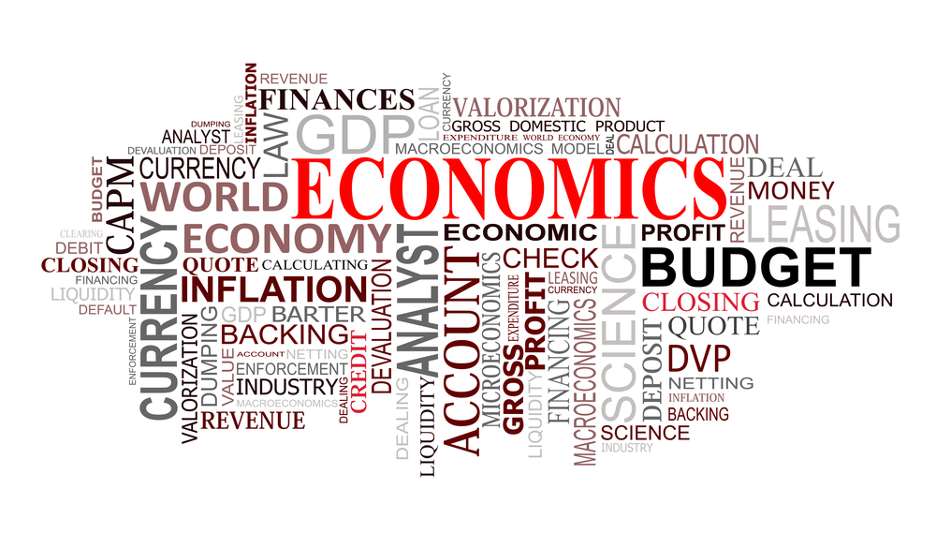
What is
Economic ?
Economics is the social science concerned with how individuals, institutions and society make optimal choices under the conditions of scarcity.

Slide 4

What is
Economics of Bangladesh?
Bangladesh is a developing country in South Asia with a mixed economy. Its economy is largely driven by agriculture, manufacturing, and services.

Slide 5


Economics History of Bangladesh
1. Pre-Colonial Period
2. Colonial Period
3. Post-Independence Period
4. The 1990s to the Present

Slide 6
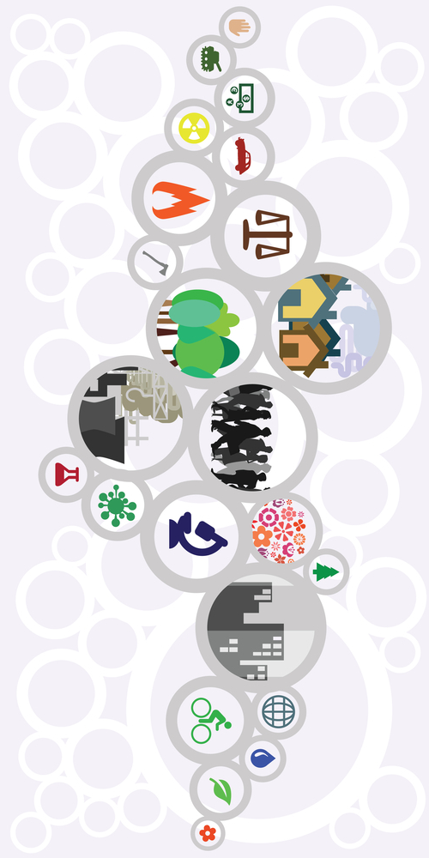
Economics Sector of Bangladesh
1. Agriculture
2. Manufacturing & Industries
3. Remittance
4. Shipbuilding and Shipbreaking
5. Finance
6. Tourism
7. Information and Communication
Technology

Slide 7
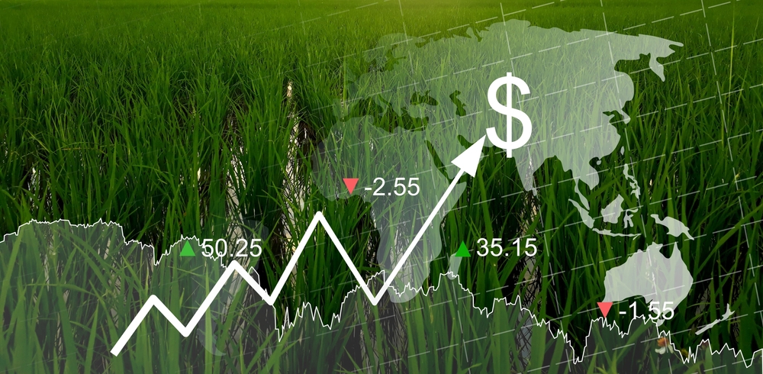
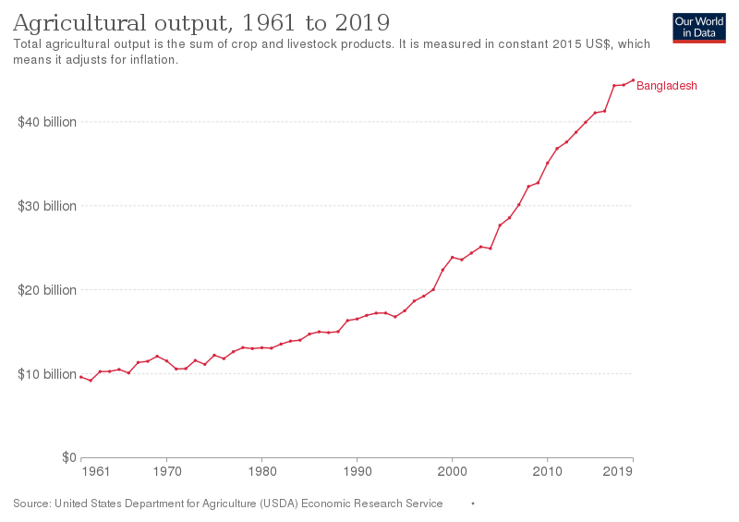
Agriculture
Agriculture is one of the primary sectors of the Bangladeshi economy, accounting for approximately 14% of the GDP and employing nearly 40% of the labor force.
The main crops produced in Bangladesh include rice, wheat, maize, jute, tea, and sugarcane.

Slide 8

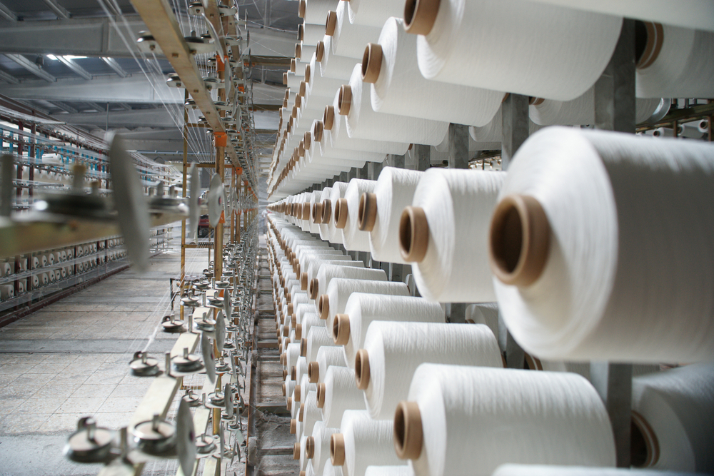
Manufacturing & Industries
The manufacturing sector is the second-largest sector of the Bangladeshi economy, accounting for around 28% of the GDP.
The country has been increasingly shifting towards labor-intensive manufacturing, particularly in the garment and textile industries, which account for more than 80% of total exports.

Slide 9

Remittance
Remittances from overseas workers are a significant source of income for many Bangladeshi families, accounting for around 7% of GDP.
Bangladesh has a large number of migrant workers, primarily in the Middle East and Southeast Asia.

Slide 10
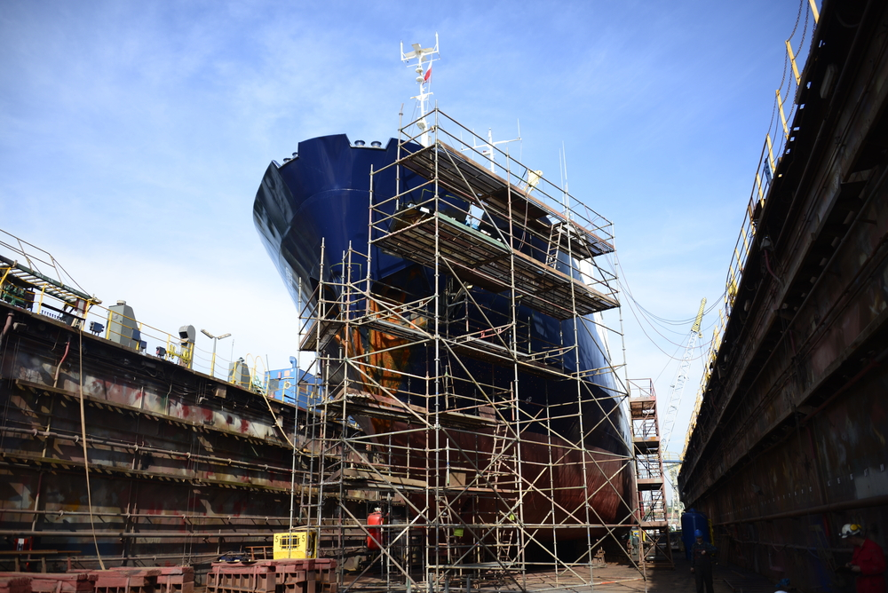
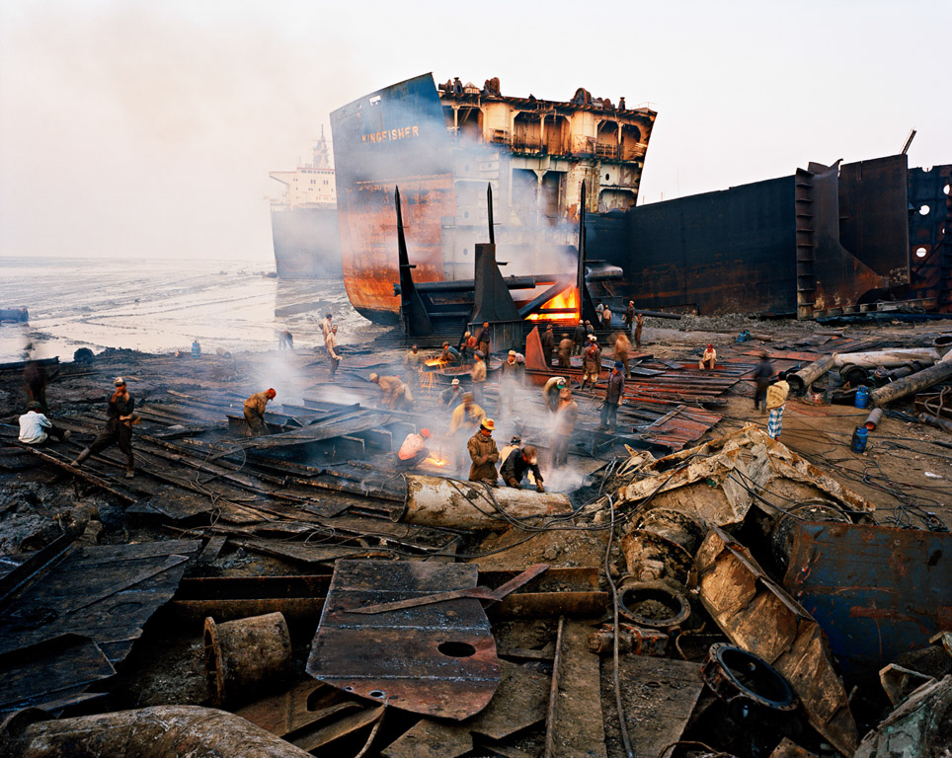
Shipbuilding & Shipbreaking
Shipbuilding and shipbreaking are two emerging industries in Bangladesh.
The shipbreaking industry is also a significant sector in Bangladesh, providing employment for thousands of workers.

Slide 11

Finance
The financial sector is growing rapidly in Bangladesh, and the country has a well-developed microfinance industry.
The Bangladesh Bank, the country's central bank, has been implementing several measures to strengthen the financial sector and attract foreign investment.

Slide 12
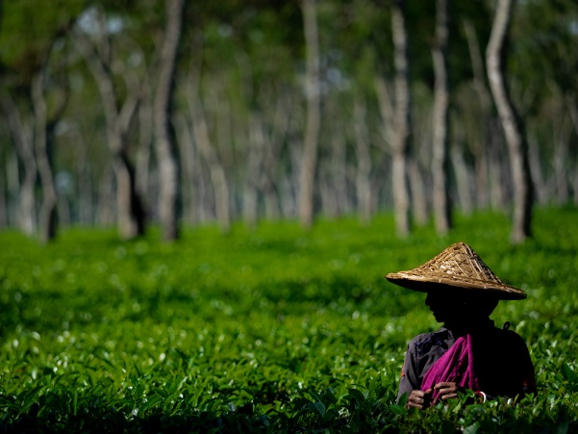


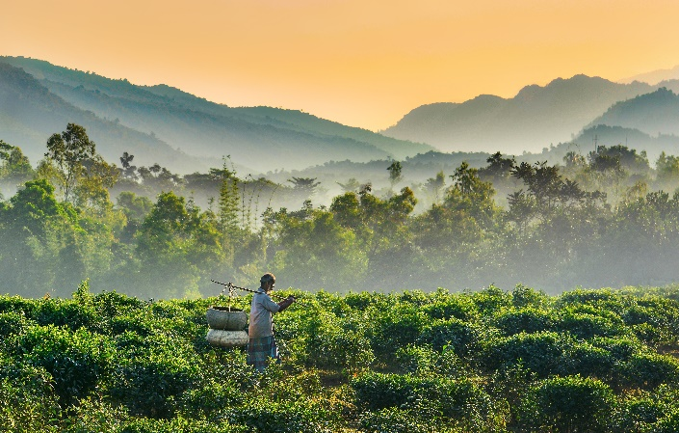
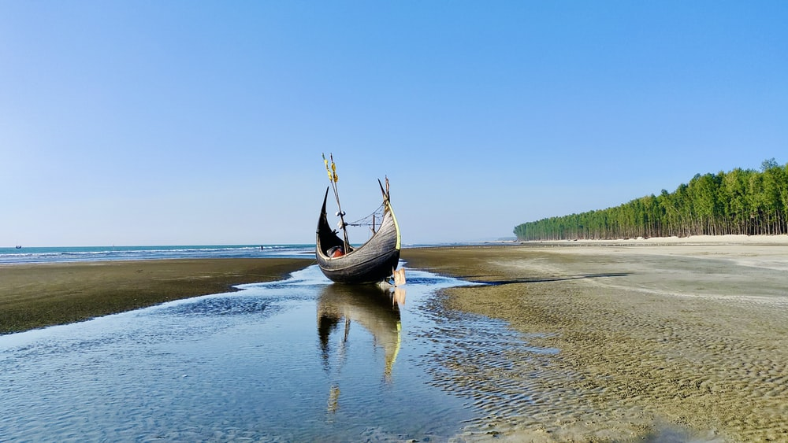
Tourism
Bangladesh has significant tourism potential, particularly in its natural attractions such as the Sundarbans mangrove forest, Cox's Bazar beach, ST. Martin Island and the Srimangal tea gardens.

Slide 13


Information and Communication Technology
The sector has seen significant growth in recent years, with a focus on outsourcing and e-commerce.
Bangladesh has exported $800 million worth of software, games, outsourcing, and services to European countries, the United States, Canada, Russia, and India

Slide 14

Economic Condition of Bangladesh
Bangladesh has experienced significant economic growth over the past decade. It is considered one of the fastest-growing economies in the world.
Here are some key aspects of Bangladesh's economic condition:
1. Gross Domestic Product (GDP)
2. Infrastructure Development
3. Challenges

Slide 15

Gross Domestic Product (GDP)
Bangladesh's GDP has been steadily increasing over the years. In recent years, the growth rate has averaged around 6-8%, although it was impacted by the COVID-19 pandemic.

Slide 16

Infrastructure Development
Bangladesh has been investing in infrastructure development, including transportation, power, and telecommunications. These investments aim to enhance connectivity, attract foreign investment, and support economic growth.

Slide 17

Challenges
Bangladesh faces several challenges, including poverty, income inequality, climate change vulnerability, and inadequate infrastructure in some areas. The country is also working to improve governance, address corruption, and create an enabling business environment.

Slide 18

Bangladesh Women and Economy
Bangladesh has made significant progress in terms of women's participation in the economy over the past few decades. According to the World Bank, women's labor force participation rate in Bangladesh increased from around 26% in the 1990s to 36% in 2020.
According to a study by the International Labour Organization (ILO), women in Bangladesh earn, on average, 12% less than men.

Slide 19

Bangladesh Women and Enterprenuership
In terms of entrepreneurship, women in Bangladesh have made significant strides. According to a report by the Global Entrepreneurship Monitor, women in Bangladesh were more likely to start businesses than men in 2020, with 11.8% of women engaged in early-stage entrepreneurial activity compared to 10.8% of men.

Slide 20
Conclusion -
In conclusion, Bangladesh's economy has been impacted by the COVID-19 pandemic and the Ukraine war, but the country has shown resilience, particularly in its garment industry, which remains a major contributor to its economy. Despite inflationary pressures, the government has implemented policies to control inflation, and the overall growth outlook for the country remains positive. However, as with any economy, there are always risks and challenges, and it will be important for Bangladesh to continue to implement policies that promote economic growth and stability in the years ahead.

Slide 21
thanks.

